Slide 1



From Data Center to Virtual Residence: Practical Strategies for Moving to and Surviving in the Cloud
Gregory A. Beamer
Director, Cloud Architecture

Slide 2

Introduction

Slide 3

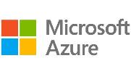

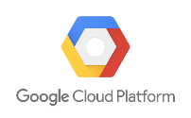
Introduction: Why Me?
25+ years in Information Technology
13 years in consulting
Early adopter of cloud technology (Azure 2010)
Multi-cloud experience
Microsoft Azure
Amazon Web Services
Google Cloud Platform
Led numerous cloud migration projects

Slide 4
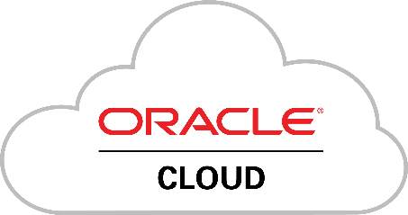
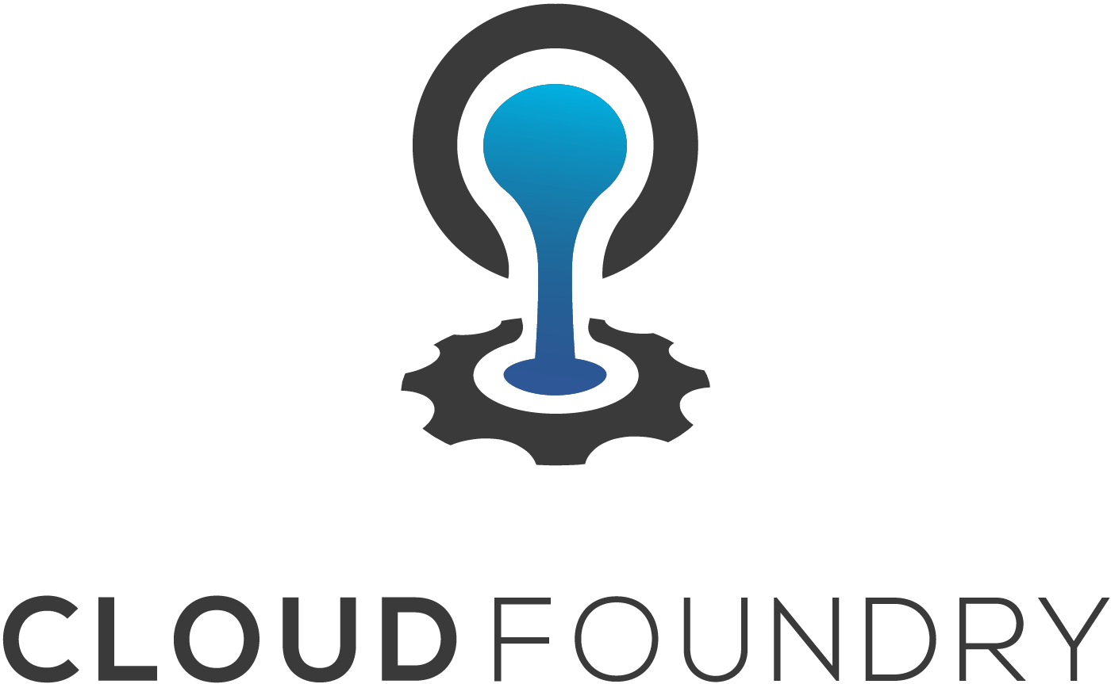

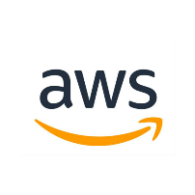
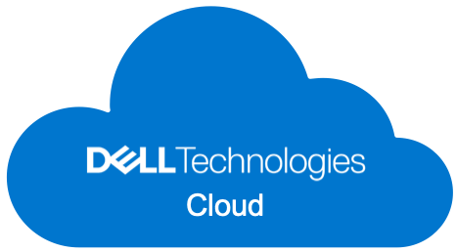
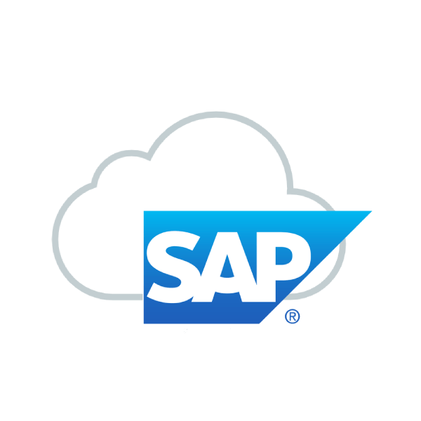

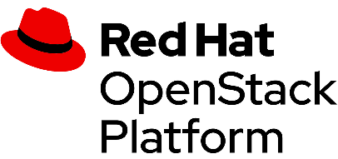
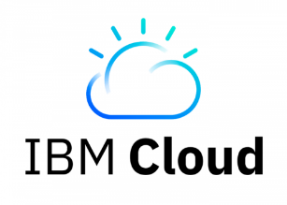
Introduction: What is Cloud?

Slide 5


Agenda
Moving to the Cloud
Ideal Migration
Roadmap for Migration
Legacy Modernization
Summary​

Slide 6

Moving to the Cloud
General Plan & Sample Migration

Slide 7
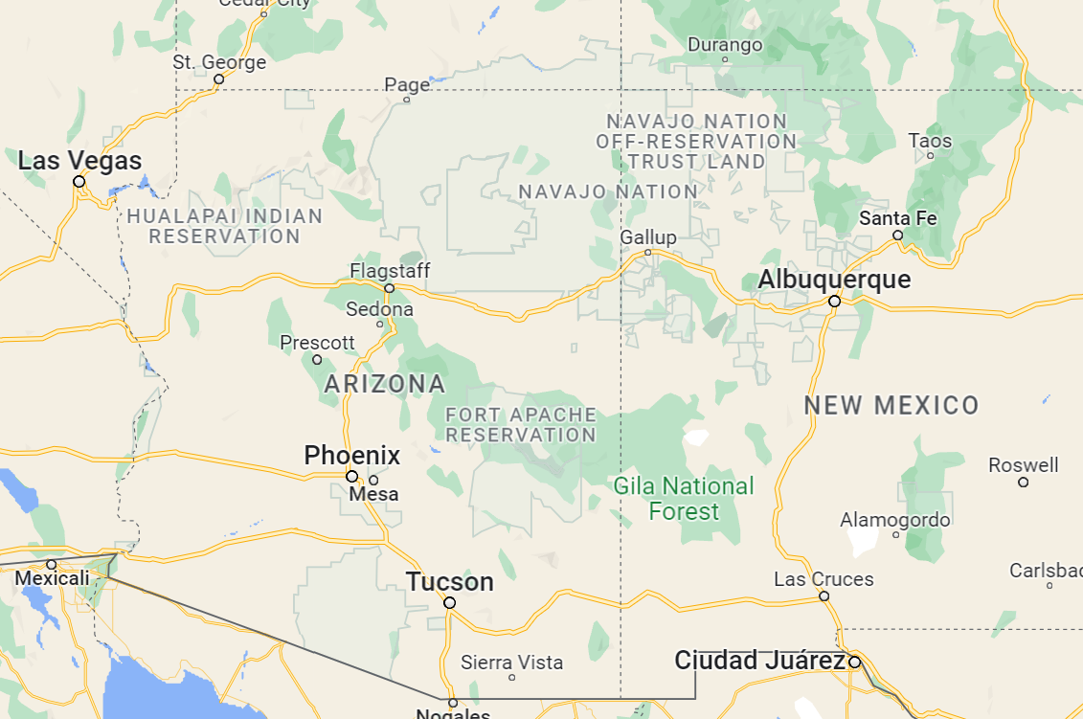
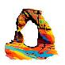
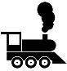















ASSESS
Things to Do
Time
Money

Slide 8
ASSESS
Things to Do
Time
Money
PLAN

Slide 9
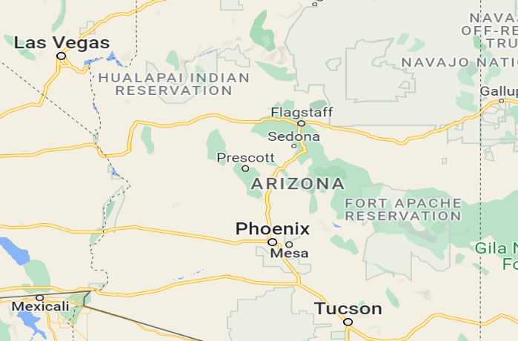


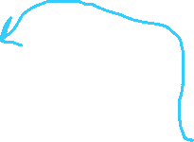






ASSESS
Things to Do
Time
Money
9
PLAN
Plan out Days “Move Groups”
8
6
4
5
Mobilize
Pack
Get up to Fly
7
3
Migrate
Vacation
2
1

Slide 10
Data Center to the Cloud
Assess
Plan
Set up Cloud
Prep Apps
Assess
Assess – Examine applications
Plan – Figure move groups & timelines
Mobilize
Set up Cloud
Prepare Applications
Migrate & Modernize
Migrate
Modernize
Tune
Migrate Apps
Validate

Slide 11

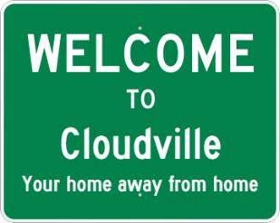
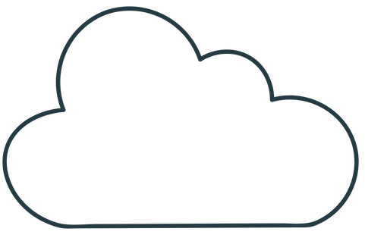
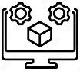
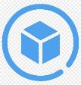
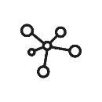
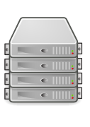

Example Migration
1
Assess
2
Plan
4
Prep Applications
3
Set up Cloud
5
Retire Data Center
5
Migrate Assets
6
Verify
7
Tune

Slide 12
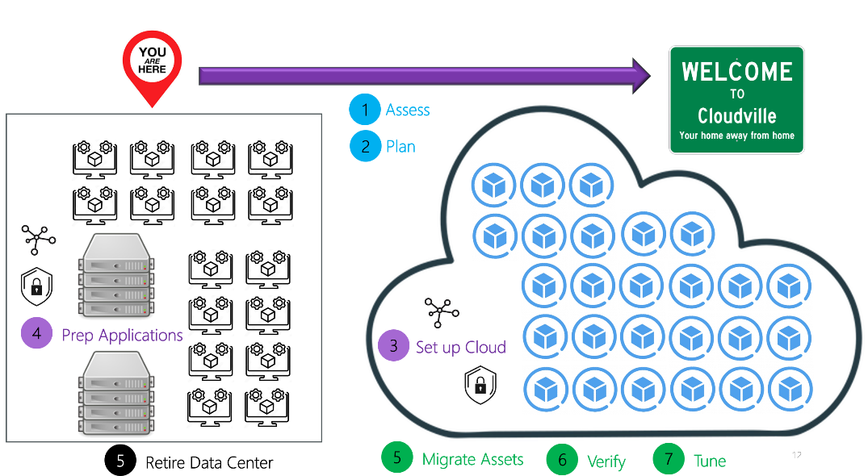

Lift & Shift
This is SO 2010s

Slide 13


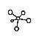
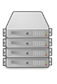

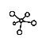

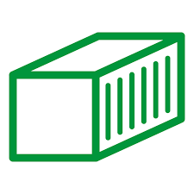

Migration Approaches
Information
Technology
Migrate
Then
Modernize
Modernize
Then
Migrate
Business

Slide 14
Business Basics
Capabilities
Commoditization
Things a Business Does
Core Capabilities – Part of the Business
Auxiliary Capabilities – Necessary, but not Core
Turning Capabilities into Commodities
Purchase from others
Cloud is a commodity

Slide 15

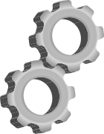

Why Move to the Cloud?
Risk
Management
Technical Concerns
Scalability, Availability,
Improved customer experience
COST

Slide 16

Ideal Migrations?
General Rules of the Road

Slide 17
Cloud Matrix
On Premise
Cloud
Infrastructure As A Service
Platform As A Service
Software As A Service
Application
Application
Application
Application
Data
Data
Data
Data
Runtime
Runtime
Runtime
Runtime
Middleware
Middleware
Middleware
Middleware
OS
OS
OS
OS
Virtualization
Virtualization
Virtualization
Virtualization
Servers
Servers
Servers
Servers
Storage
Storage
Storage
Storage
Networking
Networking
Networking
Networking
EXPENSE

Slide 18
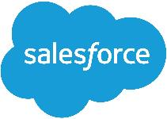
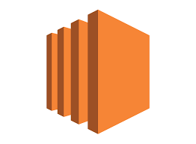
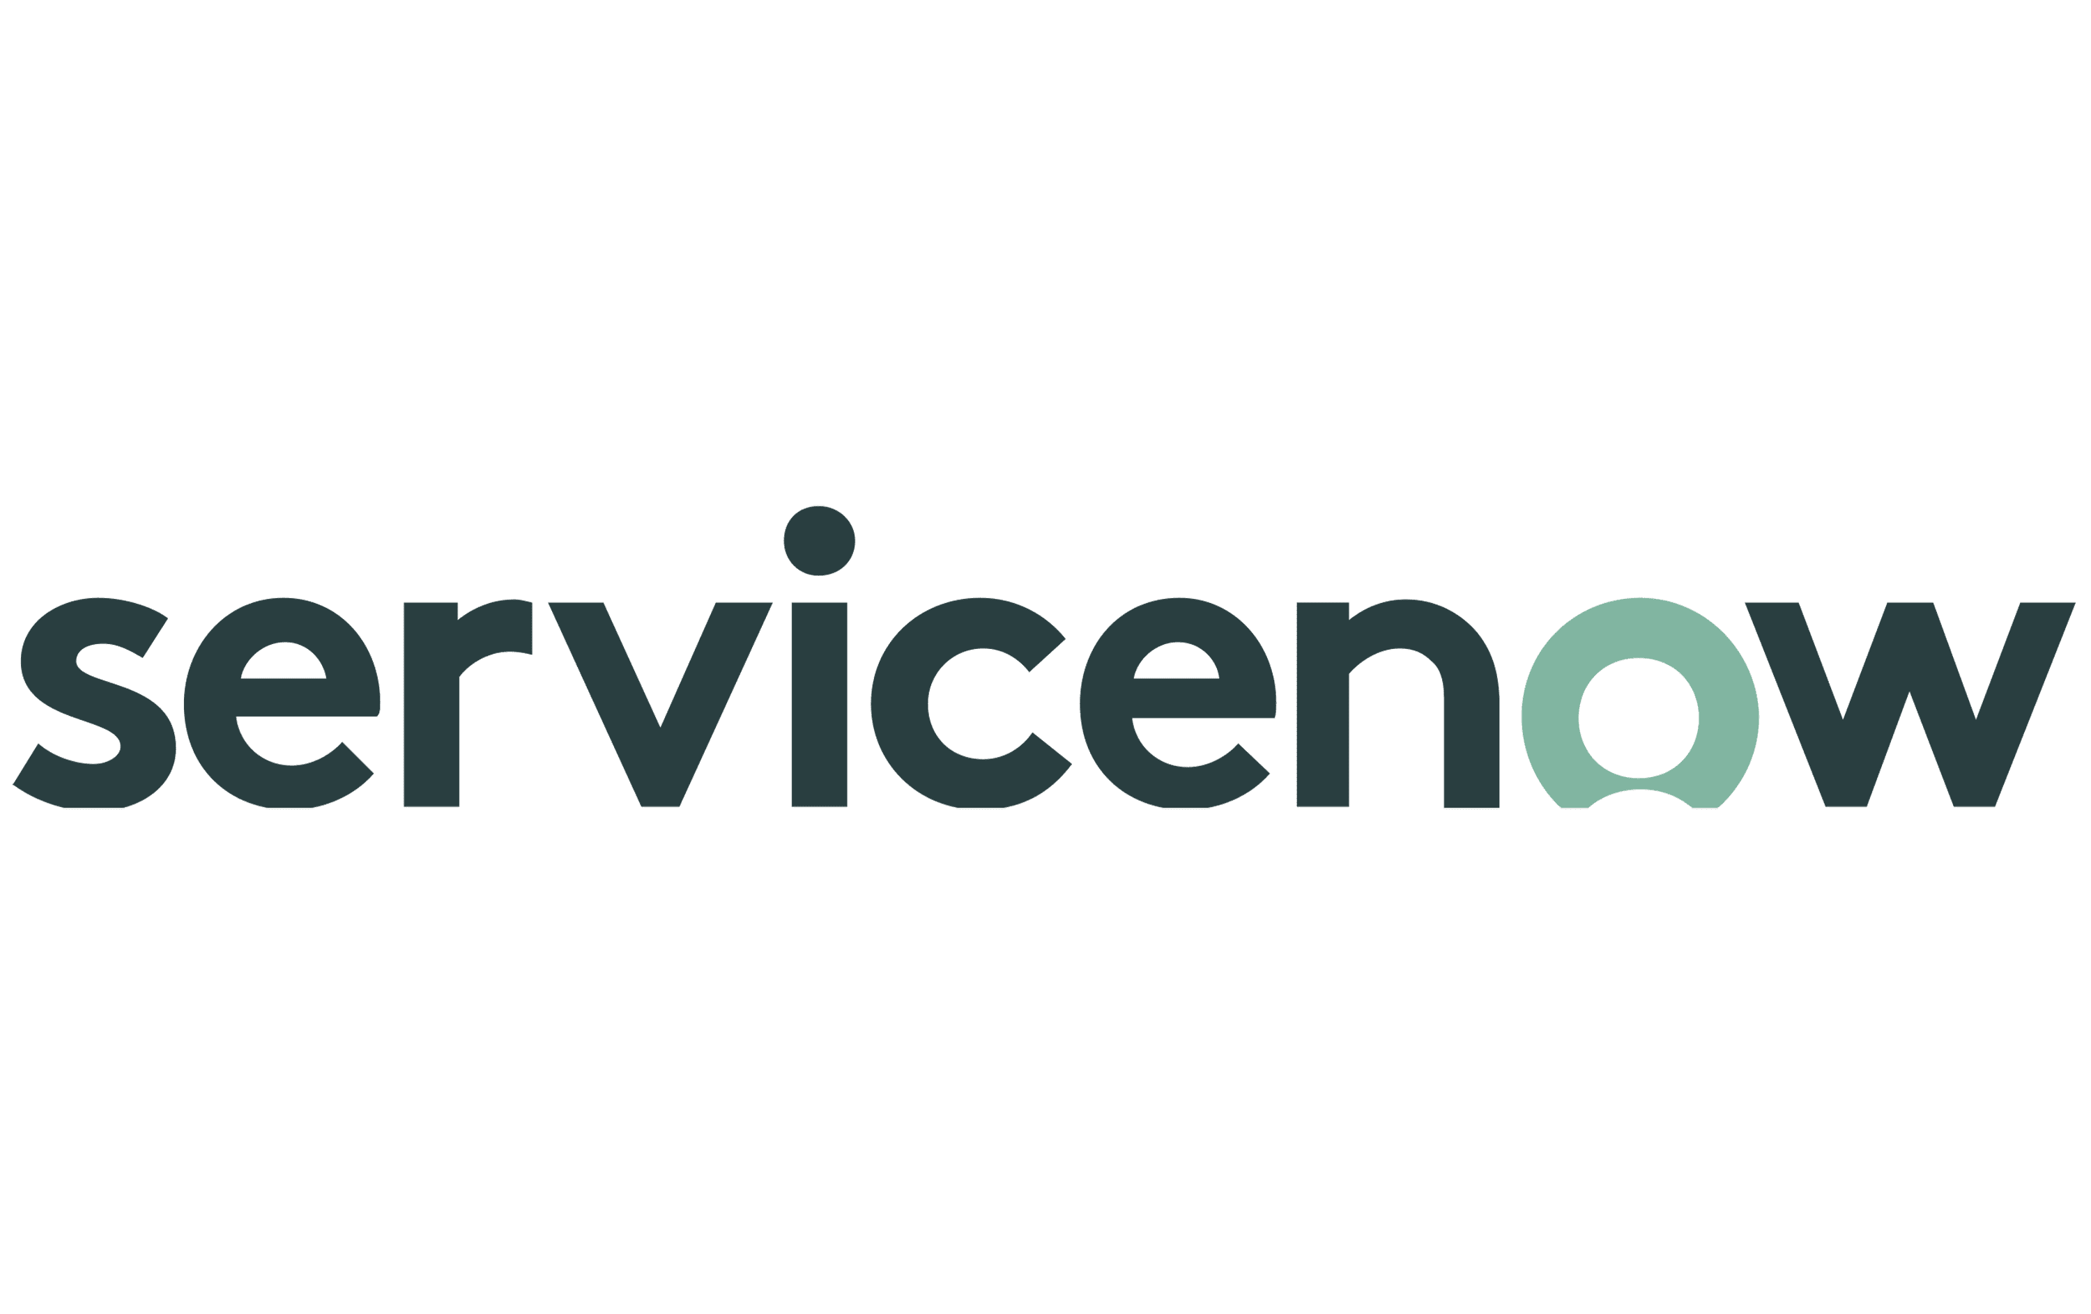

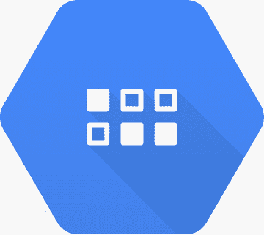
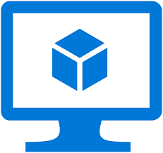
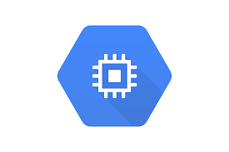

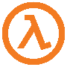
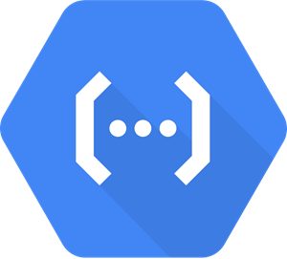

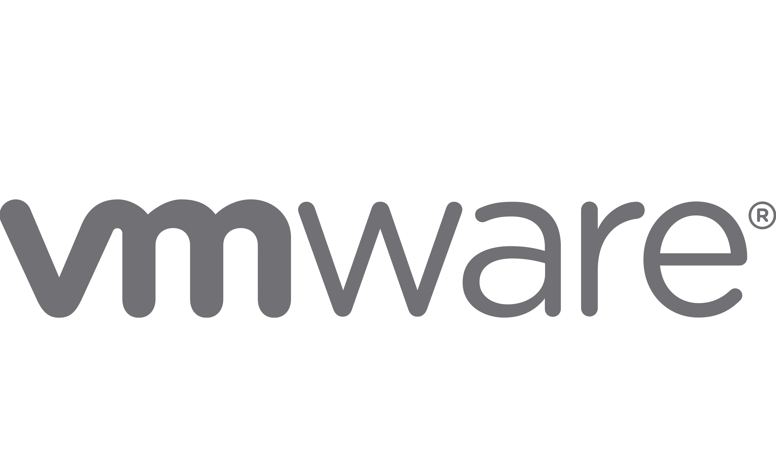

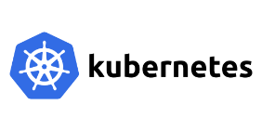

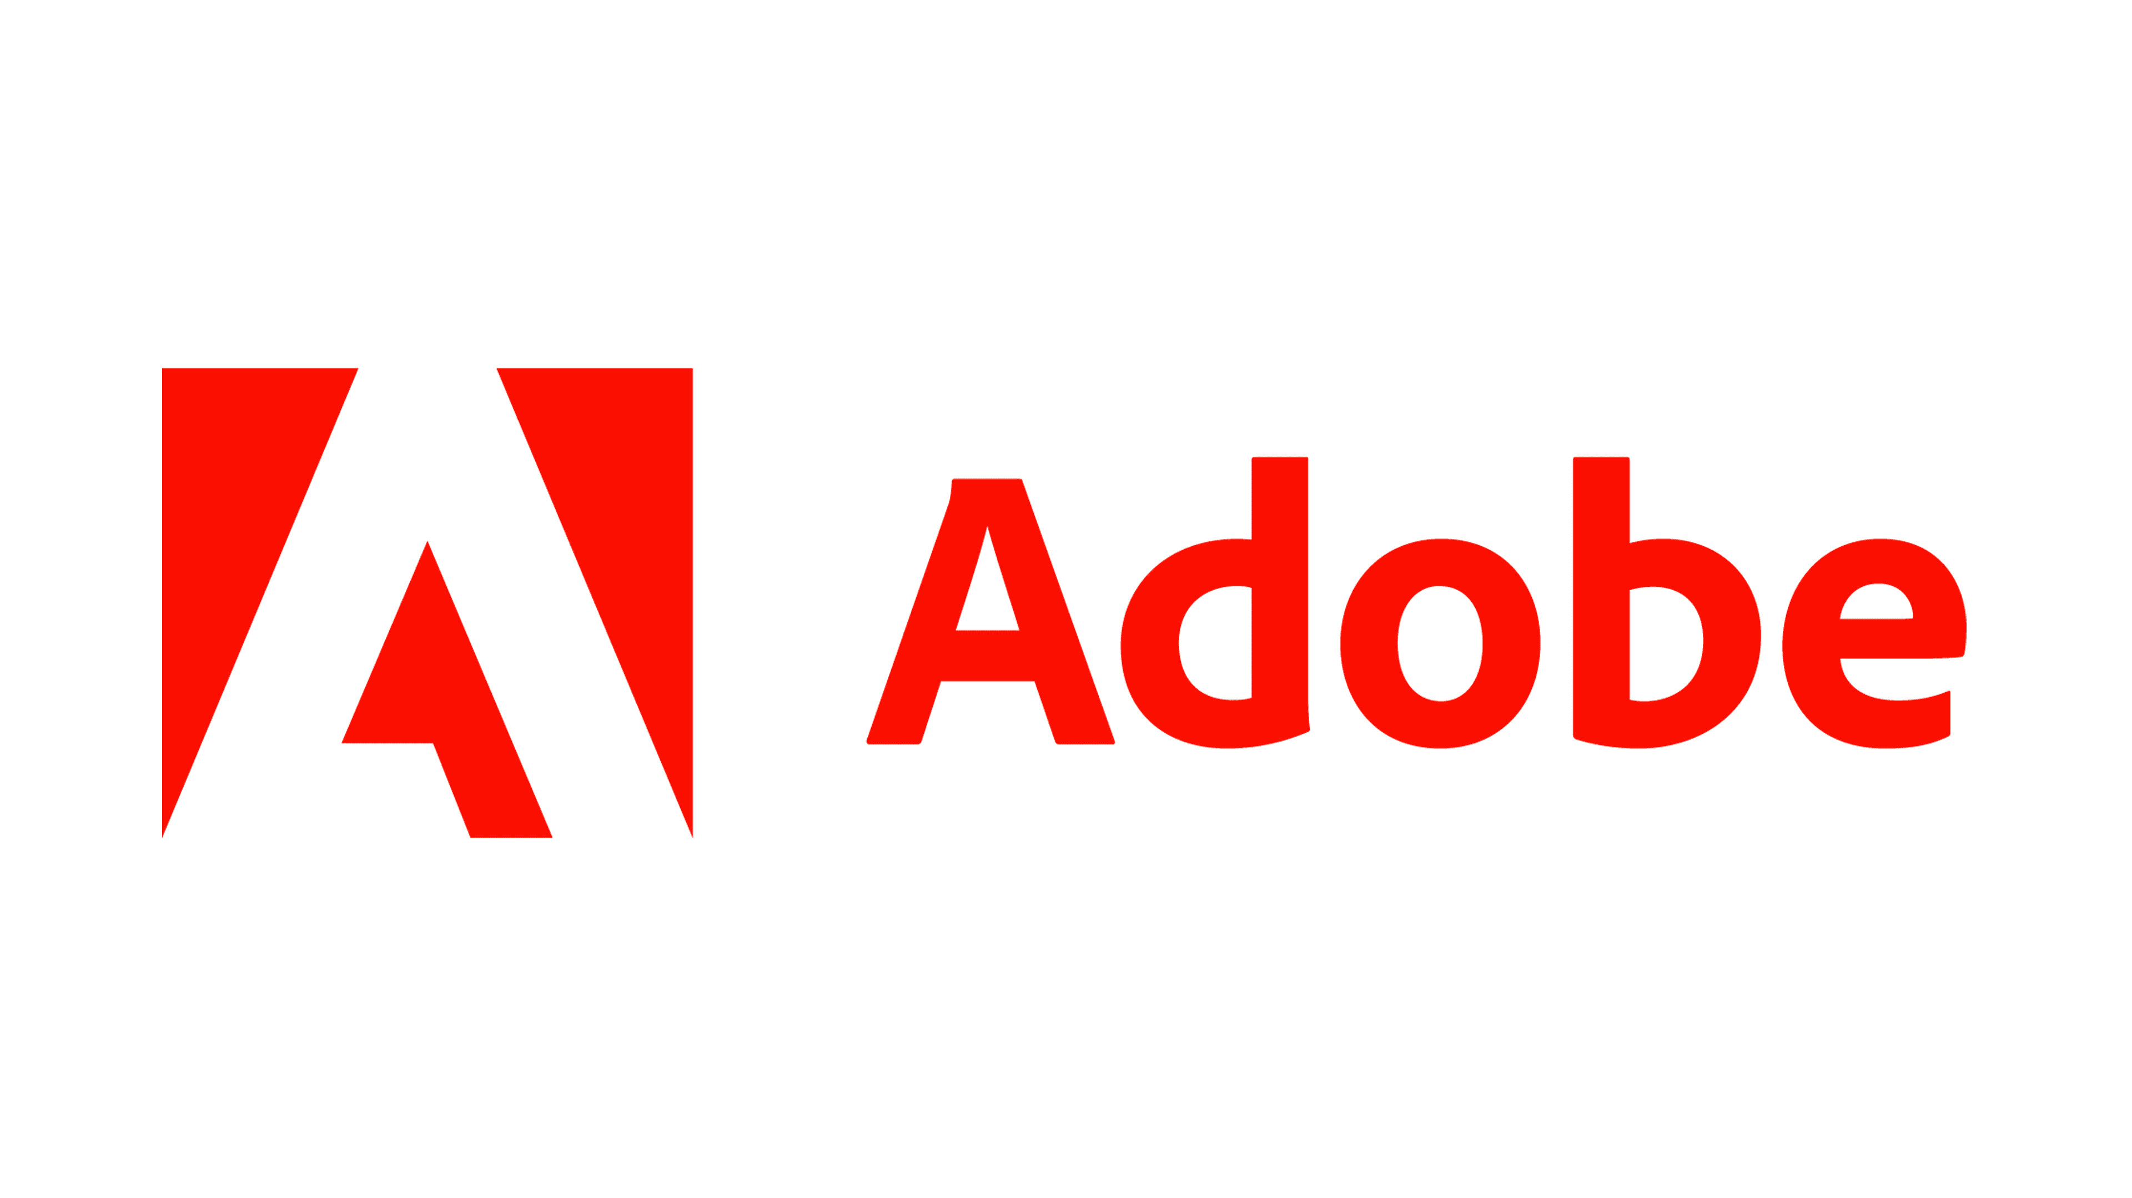
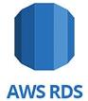
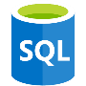



Cloud Solutions
Infrastructure as a Service
Virtual Machines
Metal on Cloud
Platform as a Service
App Services
Serverless
Database
Kubernetes Services/Containers
Software as a Service
Vendor Solutions Marketplace

Slide 19
Possible Disposition of Applications
Replatform
Cloud Enable
Custom
PaaS
Refactor
Modernize
PaaS
Retire
(no longer needed)
Retain
Keep on Premise
Rehost
Lift & Shift
Possibly IaaS
IaaS
Commercial Off The Shelf
(COTS)
Repurchase
Move to New Version
SaaS

Slide 20
Ideal Models?
Custom
COTS
Legacy
Favor modern PaaS implementations
Containerized
Larger workloads
More traditional architectures
Serverless
Smaller workloads
Can be run
API Centric models
Infrastructure and Delivery as Code (DevSecOps)
Favor SaaS implementations
Pay per user model typically
Vendors owns all but your data
Other preferred options
Change vendors to get a SaaS implementation
Retain on premise
d
Rebuild into custom models

Slide 21
Challenges
Custom
COTS
Legacy
Lack of time forces a revert to Lift & Shift (IaaS) – effort is usually larger SOLUTION: Migrate then modernize
Lack of cloud knowledge SOLUTION: Work with knowledgeable people
Immature DevOps practices inhibit automation of software delivery SOLUTION: Mature DevOps practices
Lack of a SaaS implementation, causing a reversion to IaaS models or repurchase from another vendor SOLUTION: Move to IaaS model or retire/repurchase
Older applications may not work in the cloud – some won’t work in VM SOLUTION: Retain on prem, metal on cloud
Effort for migration of data to new models - SOLUTION: Migration plan
Code generators used SOLUTION: Determine how to develop boundaries in code gen
Lack of understanding of legacy code SOLUTION: Mining expedition

Slide 22
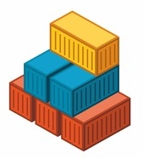
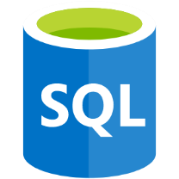
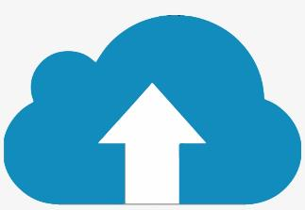
Trends in “Ideal” Models
Containers
Serverless
Cloud Native
Queued Functionality
Database
Scalable, orchestrated sites and services
Microservices
Cloud Storage

Slide 23



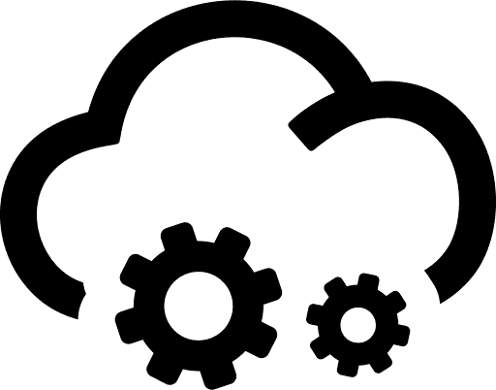


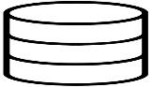
API Centric Approach
Presentation APIs
Not required in many architectures
Capability APIS (Business)
System (Persistence) APIs

Slide 24

Roadmap to the Cloud
The Process

Slide 25
Assessment
Assess
Goal
Understand all of the applications we are including in our migration plan
Deliverables
Documented understanding of applications, along with their final disposition. Included:
Business: Purpose, Criticality, and Concerns
Technical: Framework, code base, roadmap.
Dependencies: Network, OS, libraries, integrations.
Cloud Readiness: Can you move it today?
Process
Gather information
Document
Verify
Why center on applications and not infrastructure?
Applications are where business capabilities are enabled.
Plan
Set up Cloud
Prep Apps
Tune
Migrate Apps
Validate
25

Slide 26
Application Assessment Concerns
Assess
Business
Technical
Dependencies
Purpose
Business Criticality
Business Capability & Functions Served
Language/Framework: Includes version numbers
Size of Code Base
Code location
Roadmap
Database
Libraries utilized
Integrations with other Applications
Operating System
Other required software or hardware

Slide 27
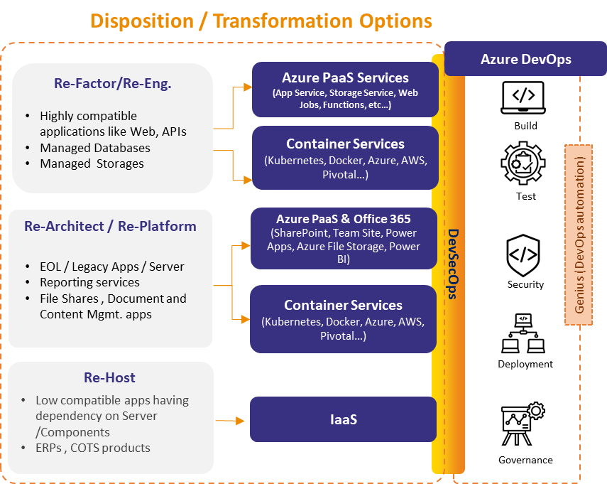
“Portfolio Rationalization”: The 6 Rs
Assess
Retire
Get rid of the application
Retain
Keep on premise
Repurchase
Change applications – usually SaaS
Rehost
Lift & Shift – move to new infrastructure – IaaS
Replatform
Alter to work on a cloud platform – PaaS
Refactor
Alter for cloud native – PaaS

Slide 28
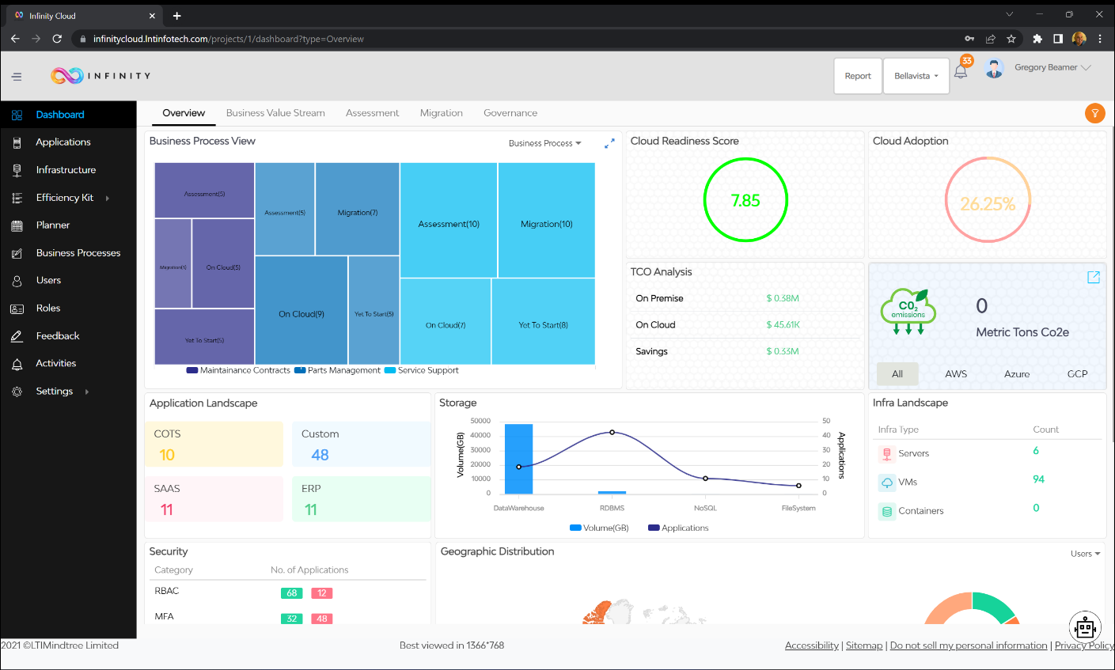
Accelerators
Assess

Slide 29
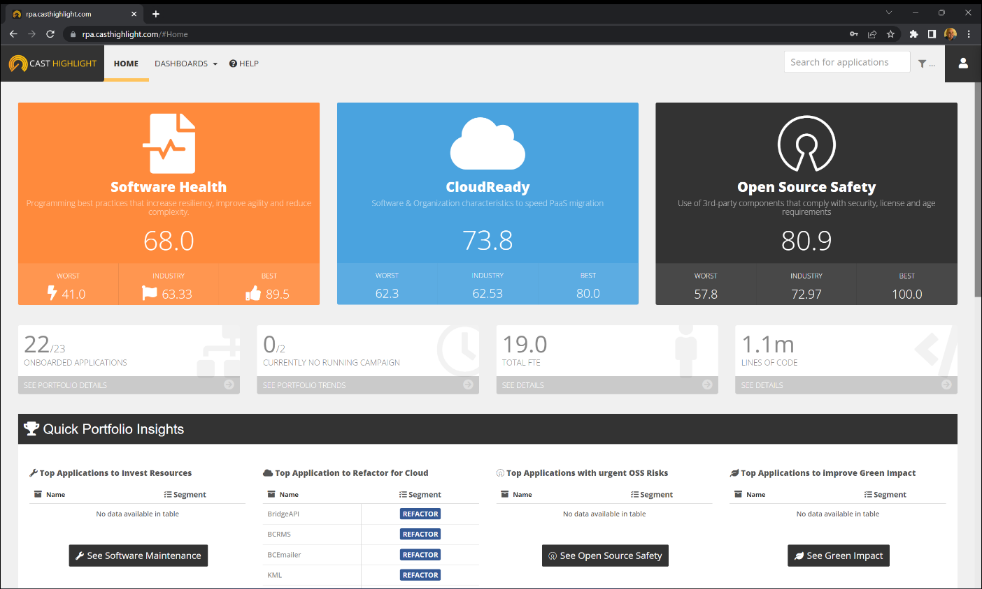
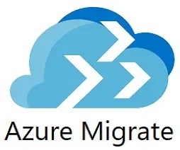
Accelerators
Assess

Slide 30

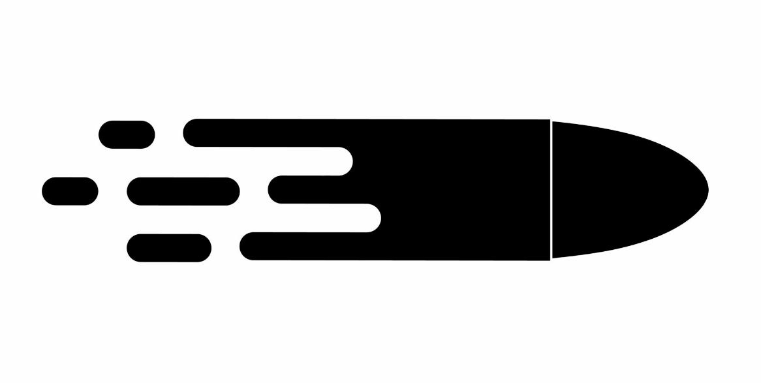
Accelerators
Assess
No magic bullets
No Magic Bullets: Have to work to get business information

Slide 31
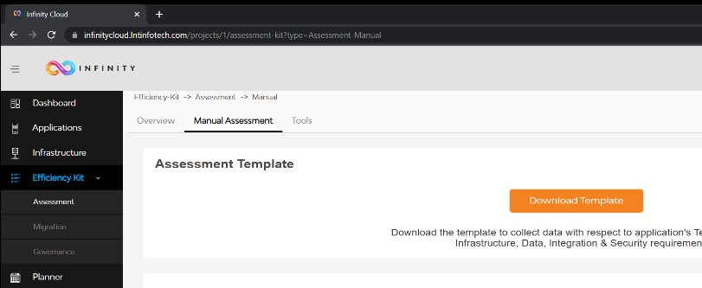

Accelerators
Assess

Slide 32
Plan
Assess
Goal
Map out the migration for all of the applications.
Deliverables
Cloud Architecture mapped to applications
Migration plan document.
Timeline for migration.
Migration waves.
Testing plan.
Software Delivery Plan (DevSecOps)
Estimated Cloud Costs Document (FinOps)
Process
Distill Assessment information
Determine Move Groups
Decide on Cloud Infrastructure Needs
Outline Migration Plan
Plan
Set up Cloud
Prep Apps
Tune
Migrate Apps
Validate
32

Slide 33



Accelerators

Slide 34
Cloud Set Up
Assess
Goal
Set up cloud for migration waves.
Deliverables
Landing Zone for application migration
Hub and require spoke(s) for migration waves
Process
Refine Architecture
Acquire Subscriptions
Set up Hub – Network, Connectivity, Security
Set up Landing Zone
Set up Spokes
Plan
Set up Cloud
Prep Apps
Tune
Migrate Apps
Validate
34

Slide 35

Hub & Spoke Model
Hub contains central functionality used across all spokes
Networking
External Connectivity
Security
Spokes center around environments, use a role-based model
Dev
QA/Test
UAT
Staging
Production

Slide 36

Landing Zone

Slide 37

Landing Zone

Slide 38
Prepare Applications
Assess
Goal
Prepare applications for chosen disposition.
Deliverables
Cloud ready application(s)
Process
Find boundaries in the application – separate concerns
Build interfaces for boundaries
Build class that adheres to the interface for the current implementation With modernization, new implementation will adhere to same interface
Plan
Set up Cloud
Prep Apps
Tune
Migrate Apps
Validate
38

Slide 39


Code Organization: The CASA Model
PRESENTATION
CORE BUSINESS
PERSISTENCE
Test
CORE
Contract
Contract
Domain
Framework(s)
Infrastructure/Networking, etc.

Slide 40








Code Organization: The CASA Model
N-Tier
PRESENTATION
CORE BUSINESS
PERSISTENCE
Contract
Test
User Interface
CORE
Web Service
Business
Framework(s)
Domain
Infrastructure/Network, etc.
Data
Domain
Contract
Framework(s)
Infrastructure/Networking, etc.
Hexagonal Architecture
Clean Architecture
Onion Architecture
UI
Adapters: Controllers,
Gateways, Presenters
Application Services
Framework
Application
Use Cases
Domain Services
Domain
Entities
Domain Model
Devices, Web, DB, UI External Interfaces
Test
Infrastructure

Slide 41
API Centric Approach
Presentation APIs
Not required in many architectures
Capability APIS (Business)
System (Persistence) APIs

Slide 42


Code Organization: The CASA Model
Presentation
Capability APIs
System APIs

Slide 43
Migration Cycle
Assess
Goal
Migrate applications in waves
Deliverables
Applications on the cloud
Applications tuned
Any required documentation
Process
Consult wave plan
Migrate applications according to plan
Validate applications are working correctly; run full test suite(s)
Tune applications
Plan
Set up Cloud
Prep Apps
Tune
Migrate Apps
Validate
43

Slide 44

Accelerators

Slide 45

Automate Software Delivery

Slide 46
Special Needs
Legacy Modernization

Slide 47





Legacy Modernization
Coding Model: Procedure based
Development Paradigm: UI/UX down (green screen driven)
Architectural model: 3-Tier model – UI, business, data. Can implement APIs in newer versions for external connectivity.
Cost model: Hardware and licenses for OS/functionality
Scale: Primarily vertical. Requires planning to scale out
State Model: Uses a stateful model, pulling data into a memory buffer when used across screens.
Garbage Collection: Developer responsibility.
Monolithic – Small monolithic structures for each screen
Data: Older versions utilize ISAM*, newer have relational structures.
Terminal
Mainframe

Slide 48






Legacy Modernization
LEGEND
Coding Model: Object Oriented
Development Paradigm: Centered around capabilities
Architectural model: APIs focused around capabilities. Individual APIs use modern architectural approaches (clean architecture)
Cost model: Pay for what you use (compute and storage)
Scale: Vertical and horizontal options. Orchestrate to auto-scale (in and out).
State model: Stateless. Information is pulled for the user on each call and saved. Idempotent
Non-monolithic: Centered around capabilities, systems focused heavy on reuse.
Capability API
System API
Interface
Adapter
Serverless

Slide 49




Legacy Modernization: REBUILD
LEGEND
Capability API
1b
System API
Interface
2
1a
Adapter
1a) Create new database structures and initial data migration 1b) Build new application 2) Refresh data and turn off mainframe access

Slide 50



Legacy Modernization: Database First
LEGEND
Capability API
5
1
System API
Interface
3
4
6
2
optional flip to micro-
service databases
Adapter
1) Organize Code 2) Create new database structures 3) Migrate legacy code 4) Build new API 5) Complete new implementation 6) Remove access to mainframe app

Slide 51
Legacy Modernization: UI First
LEGEND
Capability API
2
3
System API
1
Interface
4
5
Adapter
1) Organize Code 2) Build New UX 3) Build new core 4) Create & Connect to New Database Structures 5) Remove access to mainframe app

Slide 52
Legacy Modernization: Strangle the Middle
LEGEND
Capability API
1
System API
2
Interface
4
3
5
Adapter
1) Organize Code 2) Strangle Middle 3) Create database structures 4) Flip to new database structures 5) Remove access to mainframe app

Slide 53

Summary
Don’t default to lift & shift
Assess and Plan Properly
Reorganize your code and add interfaces
Start safe – low impact applications first
Automate your pipeline

Slide 54


Thank you
Gregory A. Beamer
gbworld@gmail.com
Twitter: @gbworld​
https://www.github.com/gbworld ​

Slide 55














Business Logic First – Strangle the Middle
User Input: Green Screen
UI/UX
Web
Mobile
Etc
Capability Service
Programs:
System Service
Interface
Database
Adapter

Slide 56


Business Logic First – Strangle the Middle
User Input: Green Screen
UI/UX
Web
Mobile
Etc
Capability Service
Programs:
System Service
Interface
Database
Adapter

Slide 57


Business Logic First – Strangle the Middle
User Input: Green Screen
Compute:
Database

Slide 58
Business Logic First – Strangle the Middle
User Input: Green Screen
Compute:
Database

Slide 59
Business Logic First – Strangle the Middle
User Input: Green Screen
Compute:
Database

